Slide 1
Concentration Camps
By: Ali Stoker

Slide 2
What are they?
People held as prisoners
Treated horrible
There are also death camps

Slide 3
Where were they?
Germany
Austria
Czechoslovakia
France
Poland
Belgium
Estonia
Finland
Holland
Italy
Latvia
Lithuania
Norway
Russia
United States

Slide 4
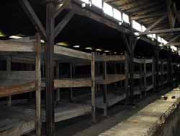
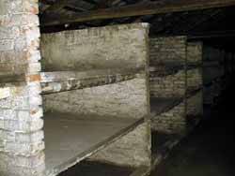
German Concentration Camps Death Camp: Auschwitz
The Auschwitz concentration camp:
Several hundred three-tier wooden bunk beds were in each building
The overcrowding in that camp made basements and lofts to be used as sleeping/ living places too
Barracks (their houses)
700 people per barrack
Dampness, leaky roofs, gross straw mattresses
Gave them worse living conditions
Diarrhea
Shortage of water for washing

Slide 5
German Concentration Camps Death Camp: Auschwitz
Feeding conditions:
3 meals
1,300 calories per day
Harder workers got 1,700
Many went through starvation periods
Went through severe exhaustion
Ended in death
Order of the day:
11 hours working every day
Food rations
Removing bugs and dirt; disinfecting

Slide 6
German Concentration Camps Death Camp: Auschwitz
Labor:
Labor was one of the words used to destroy prisoners
Building the camp
Leveling the ground, laying roads, and digging drainage ditches
Pace of the work, the starvation rations of food, and constant beatings and abuse increased the death rate.

Slide 7
Japan Camps and Prisons
Japan imprisoned 127,000 Americans during WWII
Until the camps were completed, many of the Americans were held in temporary “houses” like stables at local racetracks

Slide 8
American Camps
Ten camps in the western side of the United States
Imprisoned Japanese and Japanese-Americans
Not severe conditions

Slide 9
Sources
https://www.jewishvirtuallibrary.org/jsource/Holocaust/auconditions.html
http://www.ushistory.org/us/51e.asp
http://en.wikipedia.org/wiki/Internment_of_Japanese_Americans

